Slide 1
Finding Workorder From Notification Status and Send via Email Based on Order Type
GROUP 1

Slide 2

TEAM
Dhanush Kaduluri -280403
Nidhisha Sonaji-280408
Rashik Shaik-280402

Slide 3
Table of Contents
Package - ZG01_PACK
Introduction
Tables Used
Reports
Distribution lists
Selection Screen
OOALV Report
Adobe Form
Email Notification
Distribution Lists (PM01, PM02)
CDS View

Slide 4
Tables Used
Reports
ZG01_AFKO (Order Header Data PP Orders)
ZG01_AFVC (Operation within an order)
ZG01_AUFK (Order Master Data)
ZG01_JEST (Individual Object Status)
ZG01_QMEL (Quality Notification)
ZG01_TJ02T (system Status Text)
ZG01_TJ30T (Text for user status)
ZG01_Workorder_status
ZG01_CDS_PRGM
Distribution Lists
DL_BP_PM01
DL_BP_PMO2

Slide 5
Introduction
Created a program that will fetch workorders of the notification status passed on the selection screen.
The program sends the email intimation to the all persons in Distribution list based on order type.
The order types for which Distribution list (DL) is not maintained is displayed in ALV format.
If double clicked on any order in ALV then it should display an Adobe form.
Also, created a CDS view and used it to display the ALV Report.

Slide 6
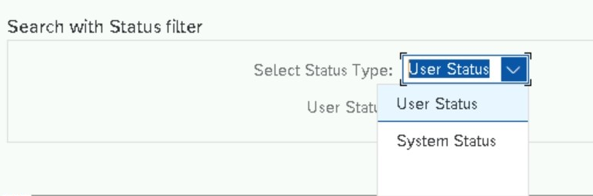
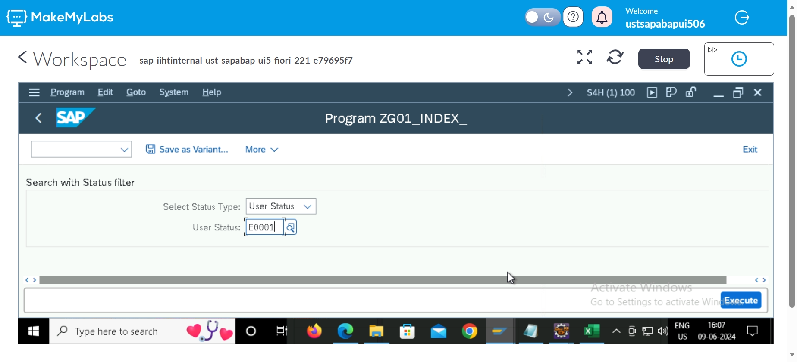
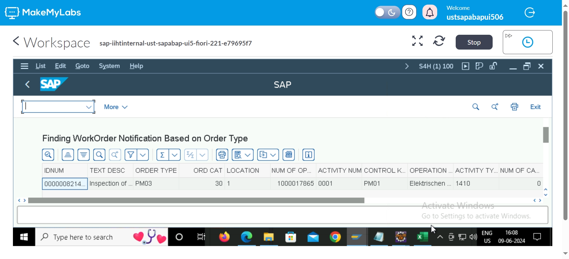
INPUTS AND OUTPUTS

Slide 7
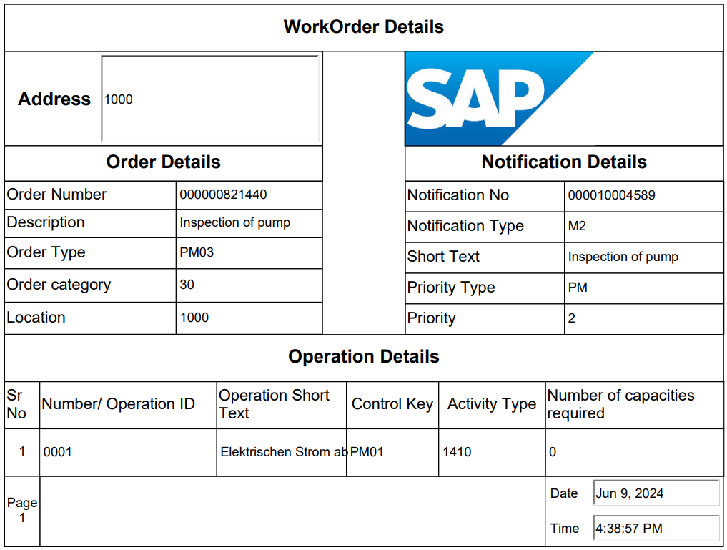
Adobe Form

Slide 8
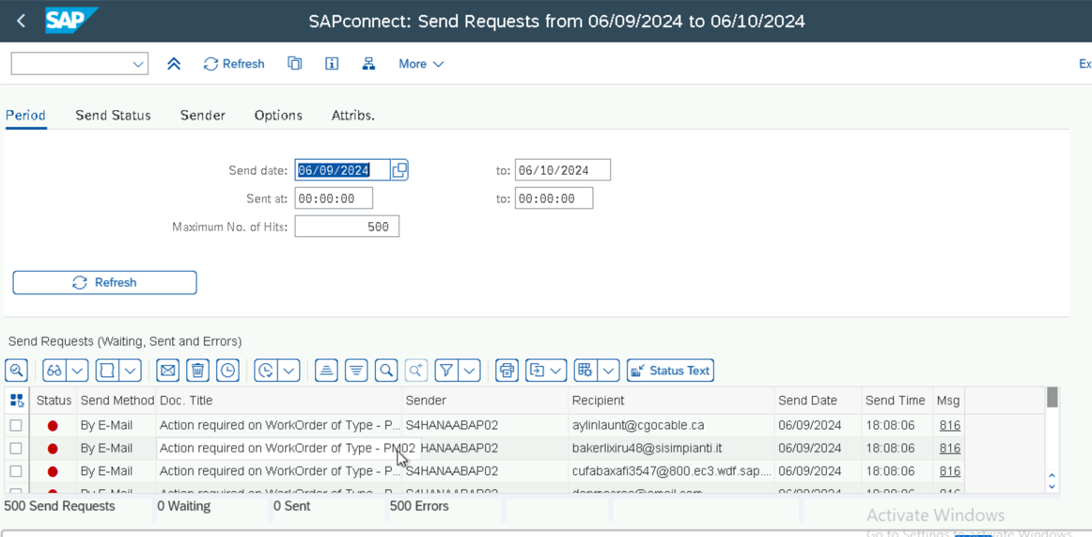
Email Notifications

Slide 9
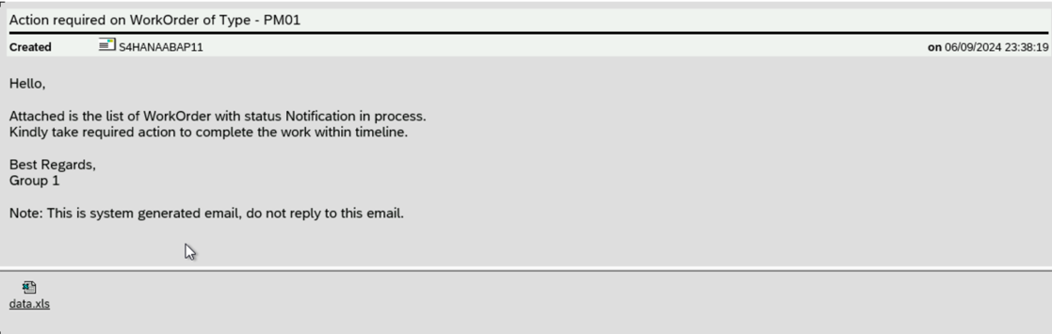
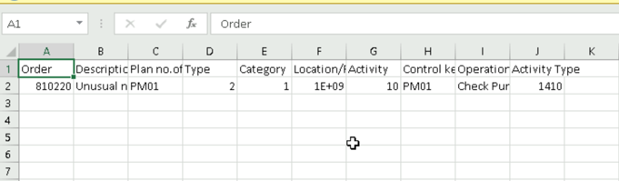
Email Body

Slide 10
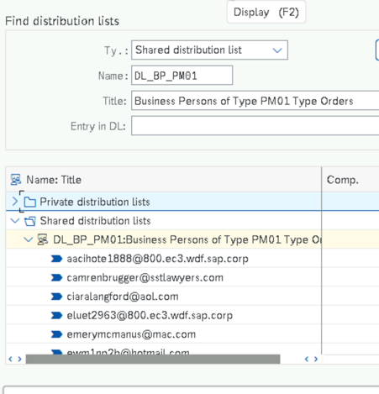
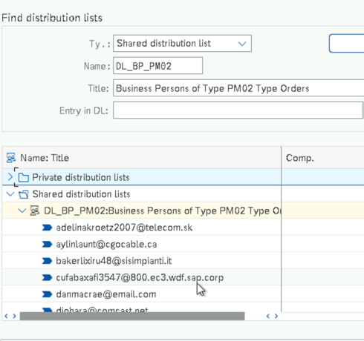
Distribution Lists

Slide 11
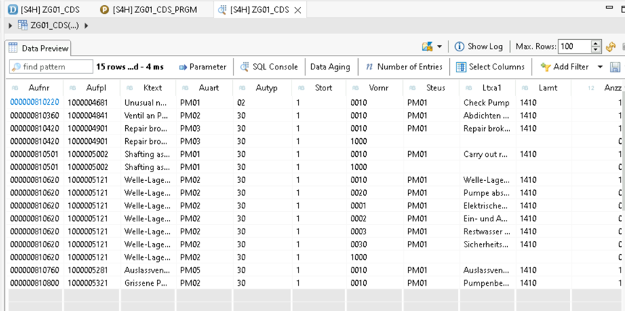
CDS View

Slide 12
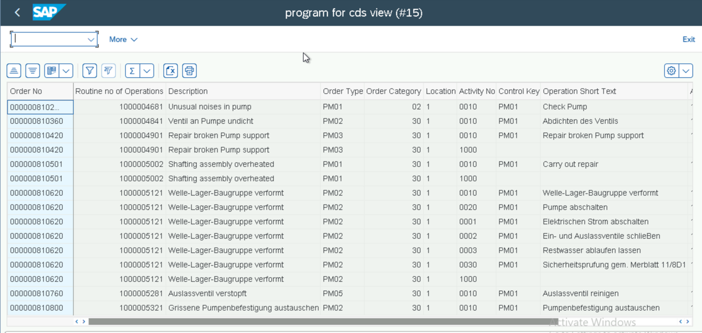
Calling CDS view through Driver program

Slide 13
Thank you

